Slide 1
5.1
Transaction Processing

Slide 2
Outline
1 Introduction to Transaction Processing
2 Transaction and System Concepts
3 Desirable Properties of Transactions
4 Characterizing Schedules based on Recoverability
5 Characterizing Schedules based on Serializability
6 Transaction Support in SQL

Slide 3
Introduction to Transaction Processing
Transaction: An executing program (process) that includes one or more database access operations
Read operations (database retrieval, such as SQL SELECT)
Write operations (modify database, such as SQL INSERT, UPDATE, DELETE)
Transaction: A logical unit of database processing
Example: Bank balance transfer of $100 dollars from a checking account to a saving account in a BANK database
Note: Each execution of a program is a distinct transaction with different parameters
Bank transfer program parameters: savings account number, checking account number, transfer amount

Slide 4
Introduction to Transaction Processing (cont.)
A transaction (set of operations) may be:
stand-alone, specified in a high level language like SQL submitted interactively, or
consist of database operations embedded within a program (most transactions)
Transaction boundaries: Begin and End transaction.
Note: An application program may contain several transactions separated by Begin and End transaction boundaries

Slide 5
Introduction to Transaction Processing (cont.)
Transaction Processing Systems: Large multi-user database systems supporting thousands of concurrent transactions (user processes) per minute
Two Modes of Concurrency
Interleaved processing: concurrent execution of processes is interleaved in a single CPU
Parallel processing: processes are concurrently executed in multiple CPUs (Figure 21.1)
Basic transaction processing theory assumes interleaved concurrency

Slide 6
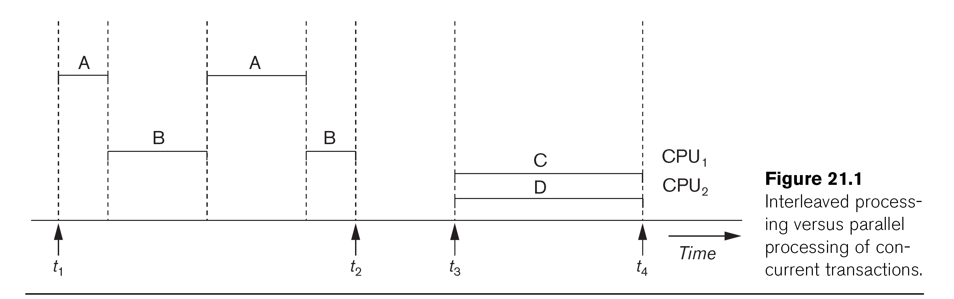

Slide 7
Introduction to Transaction Processing (cont.)
For transaction processing purposes, a simple database model is used:
A database - collection of named data items
Granularity (size) of a data item - a field (data item value), a record, or a whole disk block
TP concepts are independent of granularity
Basic operations on an item X:
read_item(X): Reads a database item named X into a program variable. To simplify our notation, we assume that the program variable is also named X.
write_item(X): Writes the value of program variable X into the database item named X.

Slide 8
Introduction to Transaction Processing (cont.)
READ AND WRITE OPERATIONS:
Basic unit of data transfer from the disk to the computer main memory is one disk block (or page). A data item X (what is read or written) will usually be the field of some record in the database, although it may be a larger unit such as a whole record or even a whole block.
read_item(X) command includes the following steps:
Find the address of the disk block that contains item X.
Copy that disk block into a buffer in main memory (if that disk block is not already in some main memory buffer).
Copy item X from the buffer to the program variable named X.

Slide 9
Introduction to Transaction Processing (cont.)
READ AND WRITE OPERATIONS (cont.):
write_item(X) command includes the following steps:
Find the address of the disk block that contains item X.
Copy that disk block into a buffer in main memory (if it is not already in some main memory buffer).
Copy item X from the program variable named X into its correct location in the buffer.
Store the updated block from the buffer back to disk (either immediately or at some later point in time).

Slide 10
Transaction Notation
Figure 21.2 (next slide) shows two examples of transactions
Notation focuses on the read and write operations
Can also write in shorthand notation:
T1: b1; r1(X); w1(X); r1(Y); w1(Y); e1;
T2: b2; r2(Y); w2(Y); e2;
bi and ei specify transaction boundaries (begin and end)
i specifies a unique transaction identifier (TId)

Slide 11
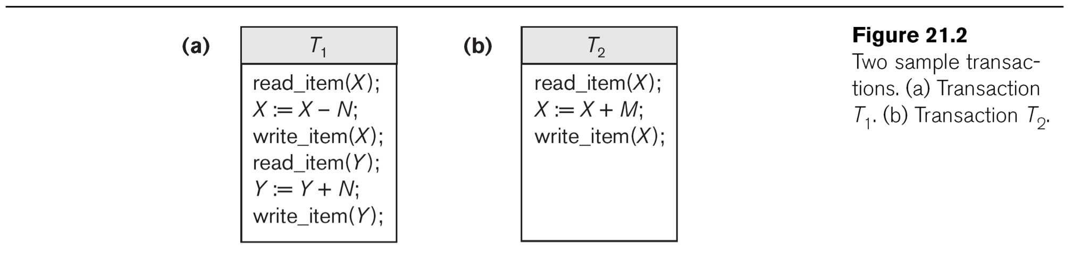

Slide 12
Why we need concurrency control
Without Concurrency Control, problems may occur with concurrent transactions:
Lost Update Problem.
Occurs when two transactions update the same data item, but both read the same original value before update (Figure 21.3(a), next slide)
The Temporary Update (or Dirty Read) Problem.
This occurs when one transaction T1 updates a database item X, which is accessed (read) by another transaction T2; then T1 fails for some reason (Figure 21.3(b)); X was (read) by T2 before its value is changed back (rolled back or UNDONE) after T1 fails

Slide 13
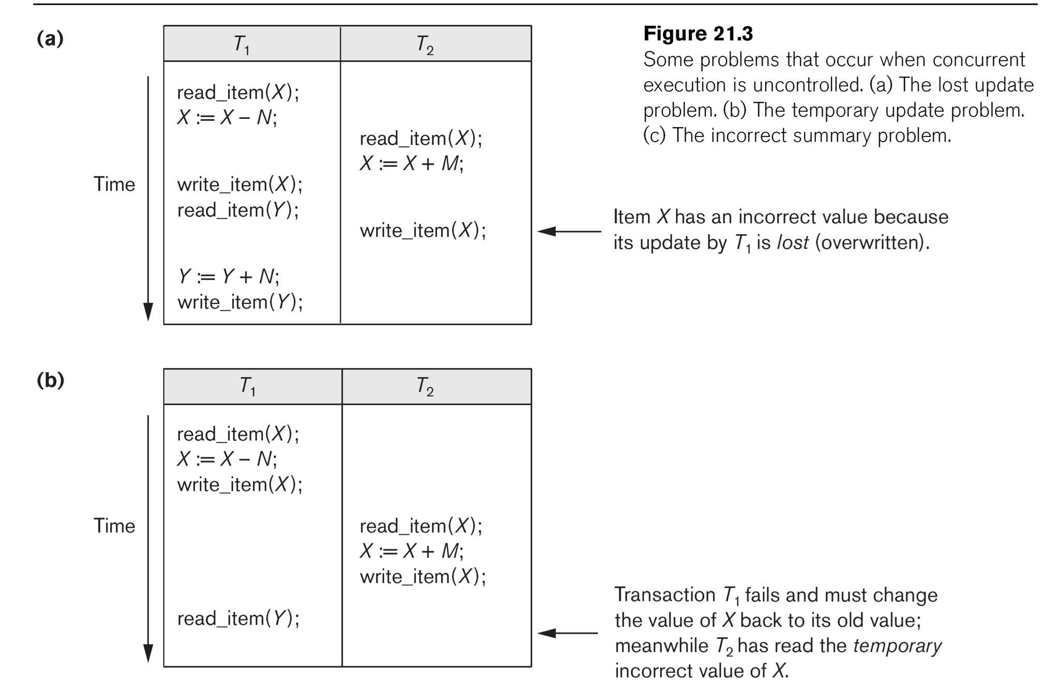

Slide 14
Why we need concurrency control (cont.)
The Incorrect Summary Problem .
One transaction is calculating an aggregate summary function on a number of records (for example, sum (total) of all bank account balances) while other transactions are updating some of these records (for example, transferring a large amount between two accounts, see Figure 21.3(c)); the aggregate function may read some values before they are updated and others after they are updated.

Slide 15
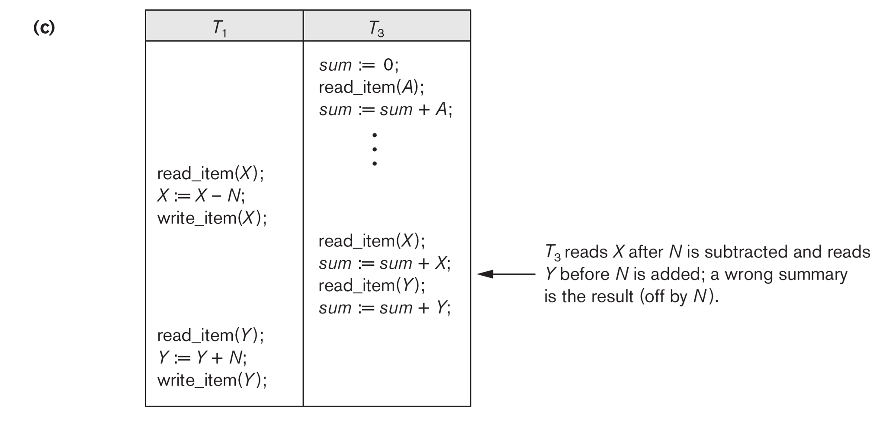

Slide 16
Why we need concurrency control (cont.)
The Unrepeatable Read Problem .
A transaction T1 may read an item (say, available seats on a flight); later, T1 may read the same item again and get a different value because another transaction T2 has updated the item (reserved seats on the flight) between the two reads by T1

Slide 17
Why recovery is needed
Causes of transaction failure:
1. A computer failure (system crash): A hardware or software error occurs during transaction execution. If the hardware crashes, the contents of the computer’s internal main memory may be lost.
2. A transaction or system error : Some operation in the transaction may cause it to fail, such as integer overflow or division by zero. Transaction failure may also occur because of erroneous parameter values or because of a logical programming error. In addition, the user may interrupt the transaction during its execution.

Slide 18
Why recovery is needed (cont.)
3. Local errors or exception conditions detected by the transaction:
- certain conditions necessitate cancellation of the transaction. For example, data for the transaction may not be found. A condition, such as insufficient account balance in a banking database, may cause a transaction, such as a fund withdrawal, to be canceled - a programmed abort causes the transaction to fail.
4. Concurrency control enforcement: The concurrency control method may decide to abort the transaction, to be restarted later, because it violates serializability or because several transactions are in a state of deadlock.

Slide 19
Why recovery is needed (cont.)
5. Disk failure: Some disk blocks may lose their data because of a read or write malfunction or because of a disk read/write head crash. This kind of failure and item 6 are more severe than items 1 through 4.
6. Physical problems and catastrophes: This refers to an endless list of problems that includes power or air-conditioning failure, fire, theft, sabotage, overwriting disks or tapes by mistake, and mounting of a wrong tape by the operator.

Slide 20
Transaction and System Concepts
A transaction is an atomic unit of work that is either completed in its entirety or not done at all. A transaction passes through several states (Figure 21.4, similar to process states in operating systems).
Transaction states:
Active state (executing read, write operations)
Partially committed state (ended but waiting for system checks to determine success or failure)
Committed state (transaction succeeded)
Failed state (transaction failed, must be rolled back)
Terminated State (transaction leaves system)

Slide 21
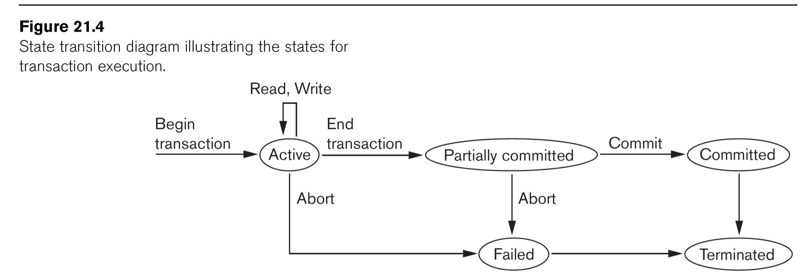

Slide 22
Transaction and System Concepts (cont.)
DBMS Recovery Manager needs system to keep track of the following operations (in the system log file):
begin_transaction: Start of transaction execution.
read or write: Read or write operations on the database items that are executed as part of a transaction.
end_transaction: Specifies end of read and write transaction operations have ended. System may still have to check whether the changes (writes) introduced by transaction can be permanently applied to the database (commit transaction); or whether the transaction has to be rolled back (abort transaction) because it violates concurrency control or for some other reason.

Slide 23
Transaction and System Concepts (cont.)
Recovery manager keeps track of the following operations (cont.):
commit_transaction: Signals successful end of transaction; any changes (writes) executed by transaction can be safely committed to the database and will not be undone.
abort_transaction (or rollback): Signals transaction has ended unsuccessfully; any changes or effects that the transaction may have applied to the database must be undone.

Slide 24
Transaction and System Concepts (cont.)
System operations used during recovery
undo(X): Similar to rollback except that it applies to a single write operation rather than to a whole transaction.
redo(X): This specifies that a write operation of a committed transaction must be redone to ensure that it has been applied permanently to the database on disk.

Slide 25
Transaction and System Concepts (cont.)
The System Log File
Is an append-only file to keep track of all operations of all transactions in the order in which they occurred. This information is needed during recovery from failures
Log is kept on disk - not affected except for disk or catastrophic failure
As with other disk files, a log main memory buffer is kept for holding the records being appended until the whole buffer is appended to the end of the log file on disk
Log is periodically backed up to archival storage (tape) to guard against catastrophic failures

Slide 26
Transaction and System Concepts (cont.)
Types of records (entries) in log file:
[start_transaction,T]: Records that transaction T has started execution.
[write_item,T,X,old_value,new_value]: T has changed the value of item X from old_value to new_value.
[read_item,T,X]: T has read the value of item X (not needed in many cases).
[end_transaction,T]: T has ended execution
[commit,T]: T has completed successfully, and committed.
[abort,T]: T has been aborted.

Slide 27
Transaction and System Concepts (cont.)
Commit Point of a Transaction:
Definition: A transaction T reaches its commit point when all its operations that access the database have been executed successfully and the effect of all the transaction operations on the database has been recorded in the log file (on disk). The transaction is then said to be committed.

Slide 28
Transaction and System Concepts (cont.)
Commit Point of a Transaction (cont.):
Log file buffers: Like database files on disk, whole disk blocks must be read or written to main memory buffers.
For log file, the last disk block (or blocks) of the file will be in main memory buffers to easily append log entries at end of file.
Force writing the log buffer: before a transaction reaches its commit point, any main memory buffers of the log that have not been written to disk yet must be copied to disk.
Called force-writing the log buffers before committing a transaction.
Needed to ensure that any write operations by the transaction are recorded in the log file on disk before the transaction commits

Slide 29
Desirable Properties of Transactions
Called ACID properties – Atomicity, Consistency, Isolation, Durability:
Atomicity: A transaction is an atomic unit of processing; it is either performed in its entirety or not performed at all.
Consistency preservation: A correct execution of the transaction must take the database from one consistent state to another.

Slide 30
Desirable Properties of Transactions (cont.)
ACID properties (cont.):
Isolation: Even though transactions are executing concurrently, they should appear to be executed in isolation – that is, their final effect should be as if each transaction was executed in isolation from start to finish.
Durability or permanency: Once a transaction is committed, its changes (writes) applied to the database must never be lost because of subsequent failure.

Slide 31
Desirable Properties of Transactions (cont.)
Atomicity: Enforced by the recovery protocol.
Consistency preservation: Specifies that each transaction does a correct action on the database on its own. Application programmers and DBMS constraint enforcement are responsible for this.
Isolation: Responsibility of the concurrency control protocol.
Durability or permanency: Enforced by the recovery protocol.

Slide 32
Schedules of Transactions
Transaction schedule (or history): When transactions are executing concurrently in an interleaved fashion, the order of execution of operations from the various transactions forms what is known as a transaction schedule (or history).
Figure 21.5 (next slide) shows 4 possible schedules (A, B, C, D) of two transactions T1 and T2:
Order of operations from top to bottom
Each schedule includes same operations
Different order of operations in each schedule

Slide 33
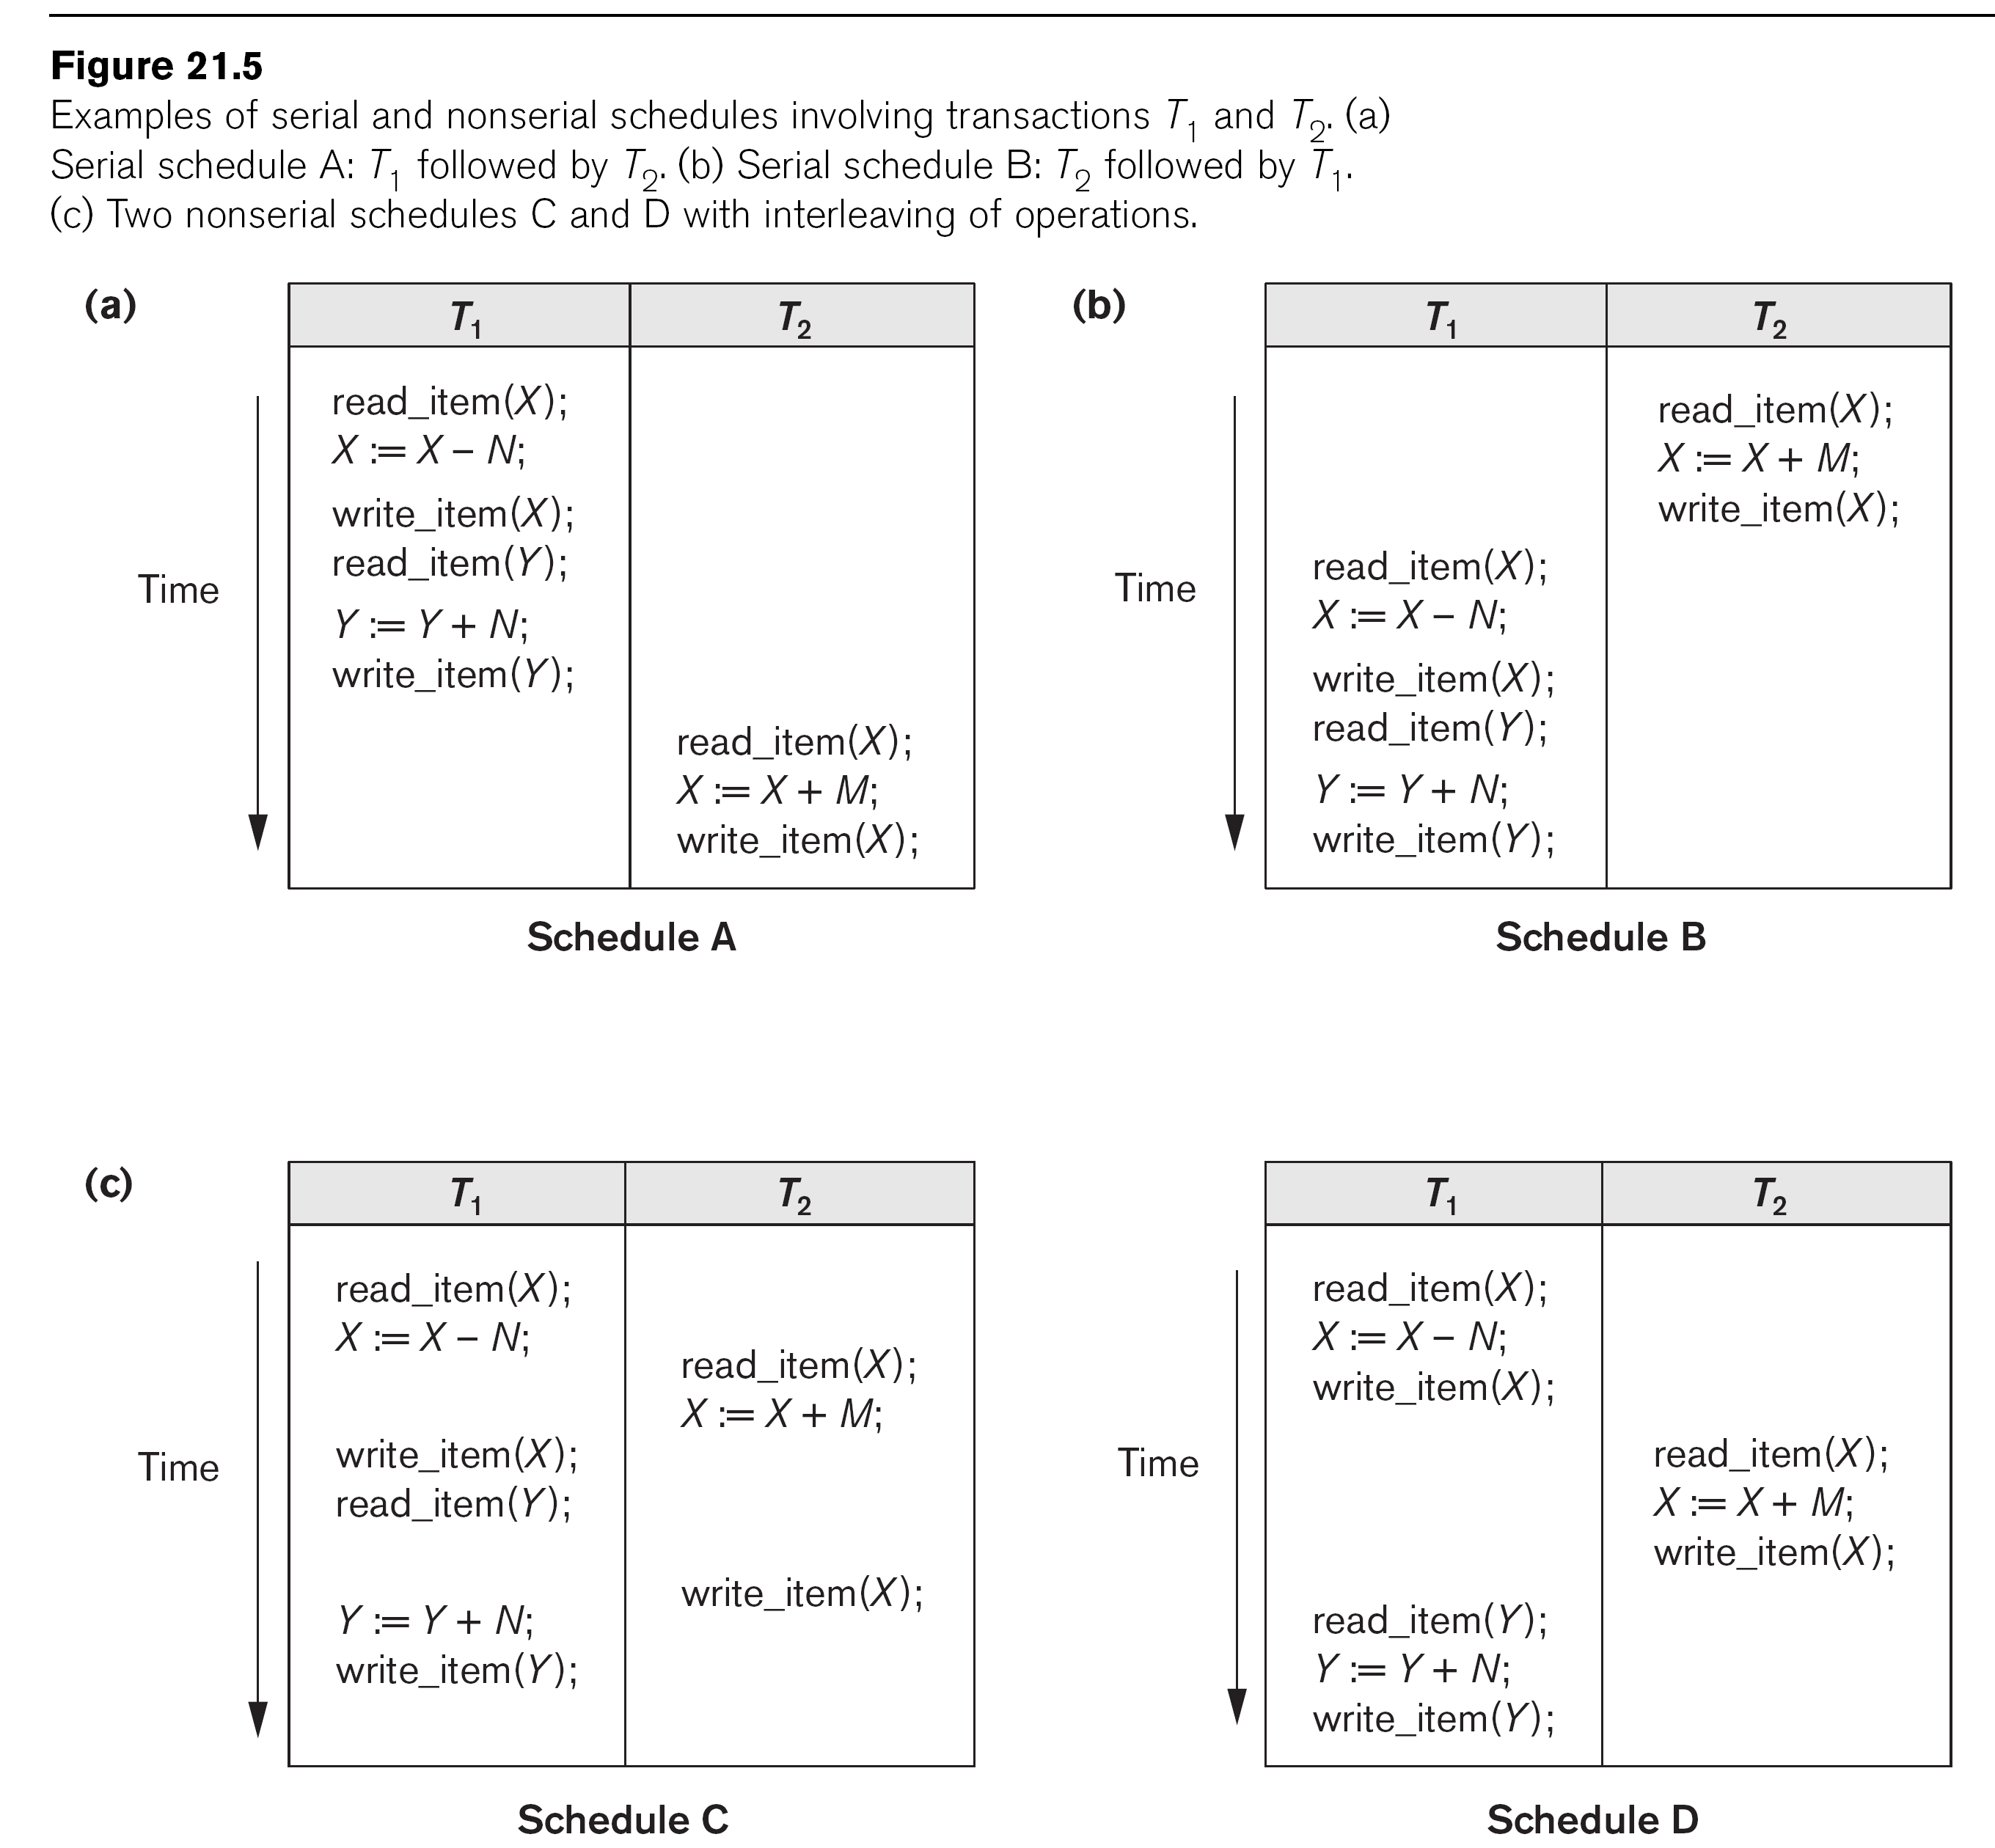

Slide 34
Schedules of Transactions (cont.)
Schedules can also be displayed in more compact notation
Order of operations from left to right
Include only read (r) and write (w) operations, with transaction id (1, 2, …) and item name (X, Y, …)
Can also include other operations such as b (begin), e (end), c (commit), a (abort)
Schedules in Figure 21.5 would be displayed as follows:
Schedule A: r1(X); w1(X); r1(Y); w1(Y); r2(X); w2(x);
Schedule B: r2(X); w2(X); r1(X); w1(X); r1(Y); w1(Y);
Schedule C: r1(X); r2(X); w1(X); r1(Y); w2(X); w1(Y);
Schedule D: r1(X); w1(X); r2(X); w2(X); r1(Y); w1(Y);

Slide 35
Characterizing Schedules based on Recoverability
Schedules classified into two main classes:
Recoverable schedule: One where no committed transaction needs to be rolled back (aborted).
A schedule S is recoverable if no transaction T in S commits until all transactions T’ that have written an item that T reads have committed.
Non-recoverable schedule: A schedule where a committed transaction may have to be rolled back during recovery.
This violates Durability from ACID properties (a committed transaction cannot be rolled back) and so non-recoverable schedules should not be allowed.

Slide 36
Characterizing Schedules Based on Recoverability (cont.)
Example: Schedule A below is non-recoverable because T2 reads the value of X that was written by T1, but then T2 commits before T1 commits or aborts
To make it recoverable, the commit of T2 (c2) must be delayed until T1 either commits, or aborts (Schedule B)
If T1 commits, T2 can commit
If T1 aborts, T2 must also abort because it read a value that was written by T1; this value must be undone (reset to its old value) when T1 is aborted
known as cascading rollback
Schedule A: r1(X); w1(X); r2(X); w2(X); c2; r1(Y); w1(Y); c1 (or a1)
Schedule B: r1(X); w1(X); r2(X); w2(X); r1(Y); w1(Y); c1 (or a1); ...

Slide 37
Characterizing Schedules based on Recoverability (cont.)
Recoverable schedules can be further refined:
Cascadeless schedule: A schedule in which a transaction T2 cannot read an item X until the transaction T1 that last wrote X has committed.
The set of cascadeless schedules is a subset of the set of recoverable schedules.
Schedules requiring cascaded rollback: A schedule in which an uncommitted transaction T2 that read an item that was written by a failed transaction T1 must be rolled back.

Slide 38
Characterizing Schedules Based on Recoverability (cont.)
Example: Schedule B below is not cascadeless because T2 reads the value of X that was written by T1 before T1 commits
If T1 aborts (fails), T2 must also be aborted (rolled back) resulting in cascading rollback
To make it cascadeless, the r2(X) of T2 must be delayed until T1 commits (or aborts and rolls back the value of X to its previous value) – see Schedule C
Schedule B: r1(X); w1(X); r2(X); w2(X); r1(Y); w1(Y); c1 (or a1);
Schedule C: r1(X); w1(X); r1(Y); w1(Y); c1; r2(X); w2(X); ...

Slide 39
Characterizing Schedules based on Recoverability (cont.)
Cascadeless schedules can be further refined:
Strict schedule: A schedule in which a transaction T2 can neither read nor write an item X until the transaction T1 that last wrote X has committed.
The set of strict schedules is a subset of the set of cascadeless schedules.

Slide 40
Characterizing Schedules Based on Recoverability (cont.)
Example: Schedule C below is cascadeless and also strict (because it has no blind writes)
Schedule D is cascadeless, but not strict (because of the blind write w3(X), which writes the value of X before T1 commits)
To make it strict, w3(X) must be delayed until after T1 commits – see Schedule E
Schedule C: r1(X); w1(X); r1(Y); w1(Y); c1; r2(X); w2(X); …
Schedule D: r1(X); w1(X); w3(X); r1(Y); w1(Y); c1; r2(X); w2(X); …
Schedule E: r1(X); w1(X); r1(Y); w1(Y); c1; w3(X); r2(X); w2(X); …

Slide 41
Characterizing Schedules Based on Recoverability (cont.)
Summary:
Many schedules can exist for a set of transactions
The set of all possible schedules can be partitioned into two subsets: recoverable and non-recoverable
A subset of the recoverable schedules are cascadeless
If blind writes are allowed, a subset of the cascadeless schedules are strict
If blind writes are not allowed, the set of cascadeless schedules is the same as the set of strict schedules

Slide 42
Characterizing Schedules based on Serializability
Among the large set of possible schedules, we want to characterize which schedules are guaranteed to give a correct result
The consistency preservation property of the ACID properties states that: each transaction if executed on its own (from start to finish) will transform a consistent state of the database into another consistent state
Hence, each transaction is correct on its own

Slide 43
Characterizing Schedules based on Serializability (cont.)
Serial schedule: A schedule S is serial if, for every transaction T participating in the schedule, all the operations of T are executed consecutively (without interleaving of operations from other transactions) in the schedule. Otherwise, the schedule is called nonserial.
Based on the consistency preservation property, any serial schedule will produce a correct result (assuming no inter-dependencies among different transactions)

Slide 44
Characterizing Schedules based on Serializability (cont.)
Serial schedules are not feasible for performance reasons:
No interleaving of operations
Long transactions force other transactions to wait
System cannot switch to other transaction when a transaction is waiting for disk I/O or any other event
Need to allow concurrency with interleaving without sacrificing correctness

Slide 45
Characterizing Schedules based on Serializability (cont.)
Serializable schedule: A schedule S is serializable if it is equivalent to some serial schedule of the same n transactions.
There are (n)! serial schedules for n transactions – a serializable schedule can be equivalent to any of the serial schedules
Question: How do we define equivalence of schedules?

Slide 46
Equivalence of Schedules
Result equivalent: Two schedules are called result equivalent if they produce the same final state of the database.
Difficult to determine without analyzing the internal operations of the transactions, which is not feasible in general.
May also get result equivalence by chance for a particular input parameter even though schedules are not equivalent in general (see Figure 21.6, next slide)

Slide 47
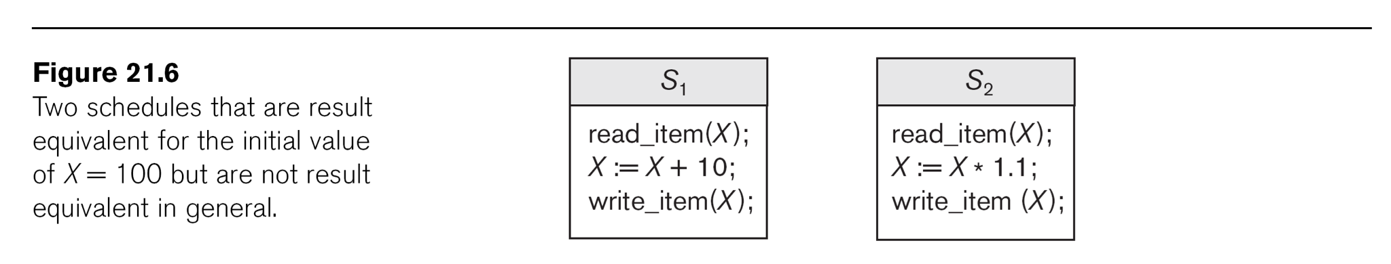

Slide 48
Equivalence of Schedules (cont.)
Conflict equivalent: Two schedules are conflict equivalent if the relative order of any two conflicting operations is the same in both schedules.
Commonly used definition of schedule equivalence
Two operations are conflicting if:
They access the same data item X
They are from two different transactions
At least one is a write operation
Read-Write conflict example: r1(X) and w2(X)
Write-write conflict example: w1(Y) and w2(Y)

Slide 49
Equivalence of Schedules (cont.)
Changing the order of conflicting operations generally causes a different outcome
Example: changing r1(X); w2(X) to w2(X); r1(X) means that T1 will read a different value for X
Example: changing w1(Y); w2(Y) to w2(Y); w1(Y) means that the final value for Y in the database can be different
Note that read operations are not conflicting; changing r1(Z); r2(Z) to r2(Z); r1(Z) does not change the outcome

Slide 50
Characterizing Scedules Based on Serializability (cont.)
Conflict equivalence of schedules is used to determine which schedules are correct in general (serializable)
A schedule S is said to be serializable if it is conflict equivalent to some serial schedule S’.

Slide 51
Characterizing Schedules based on Serializability (cont.)
A serializable schedule is considered to be correct because it is equivalent to a serial schedule, and any serial schedule is considered to be correct
It will leave the database in a consistent state.
The interleaving is appropriate and will result in a state as if the transactions were serially executed, yet will achieve efficiency due to concurrent execution and interleaving of operations from different transactions.

Slide 52
Characterizing Schedules based on Serializability (cont.)
Serializability is generally hard to check at run-time:
Interleaving of operations is generally handled by the operating system through the process scheduler
Difficult to determine beforehand how the operations in a schedule will be interleaved
Transactions are continuously started and terminated

Slide 53
Characterizing Schedules Based on Serializability (cont.)
Practical approach:
Come up with methods (concurrency control protocols) to ensure serializability (discussed in Chapter 22)
DBMS concurrency control subsystem will enforce the protocol rules and thus guarantee serializability of schedules
Current approach used in most DBMSs:
Use of locks with two phase locking (see Section 22.1)

Slide 54
Characterizing Schedules based on Serializability (cont.)
Testing for conflict serializability
Algorithm 21.1:
Looks at only r(X) and w(X) operations in a schedule
Constructs a precedence graph (serialization graph) – one node for each transaction, plus directed edges
An edge is created from T_{i} to T_{j} if one of the operations in T_{i} appears before a conflicting operation in T_{j}
The schedule is serializable if and only if the precedence graph has no cycles.

Slide 55
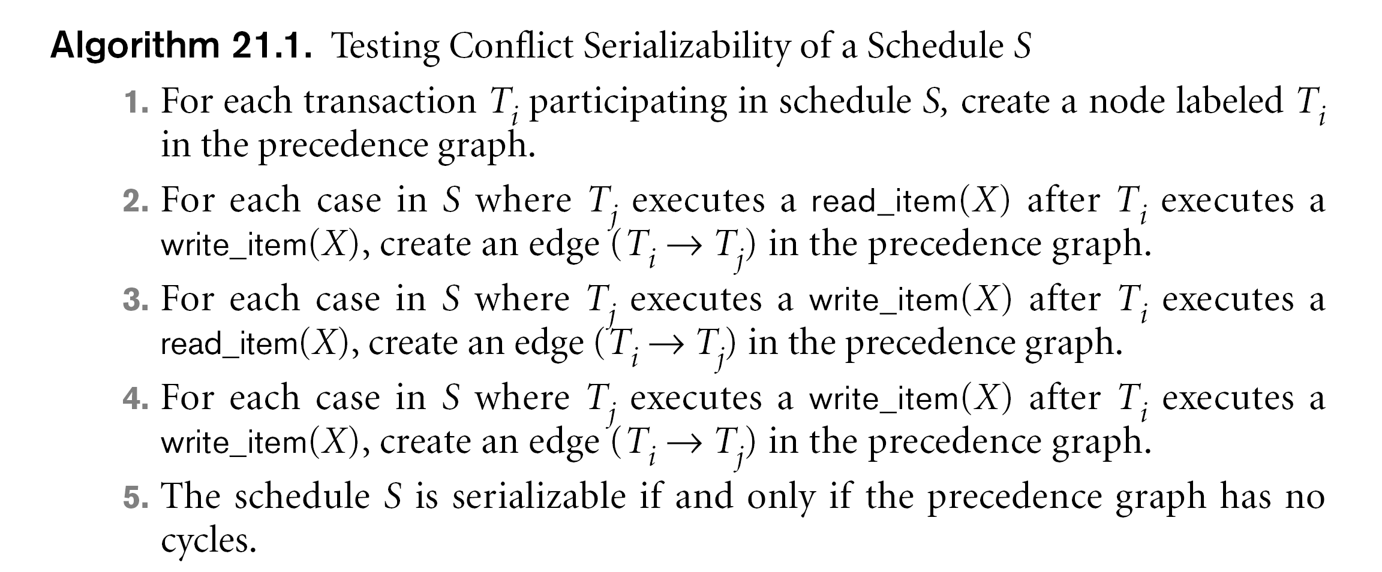

Slide 56
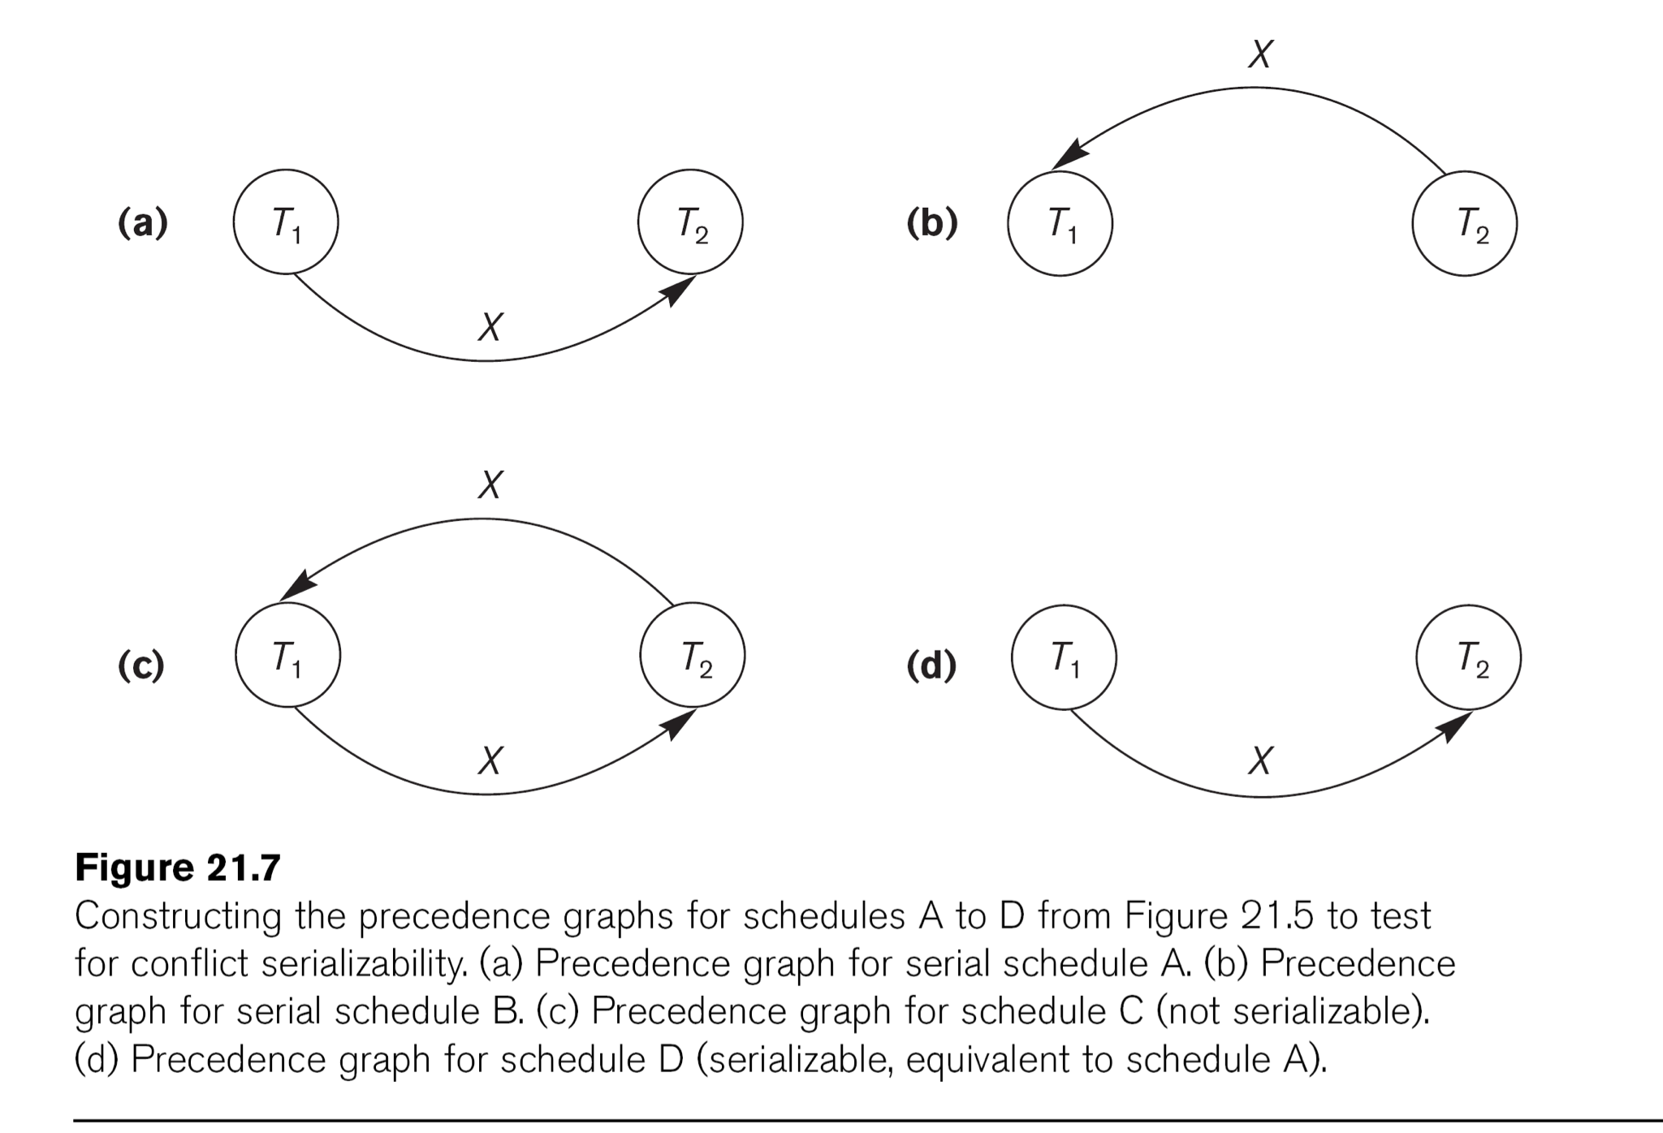

Slide 57
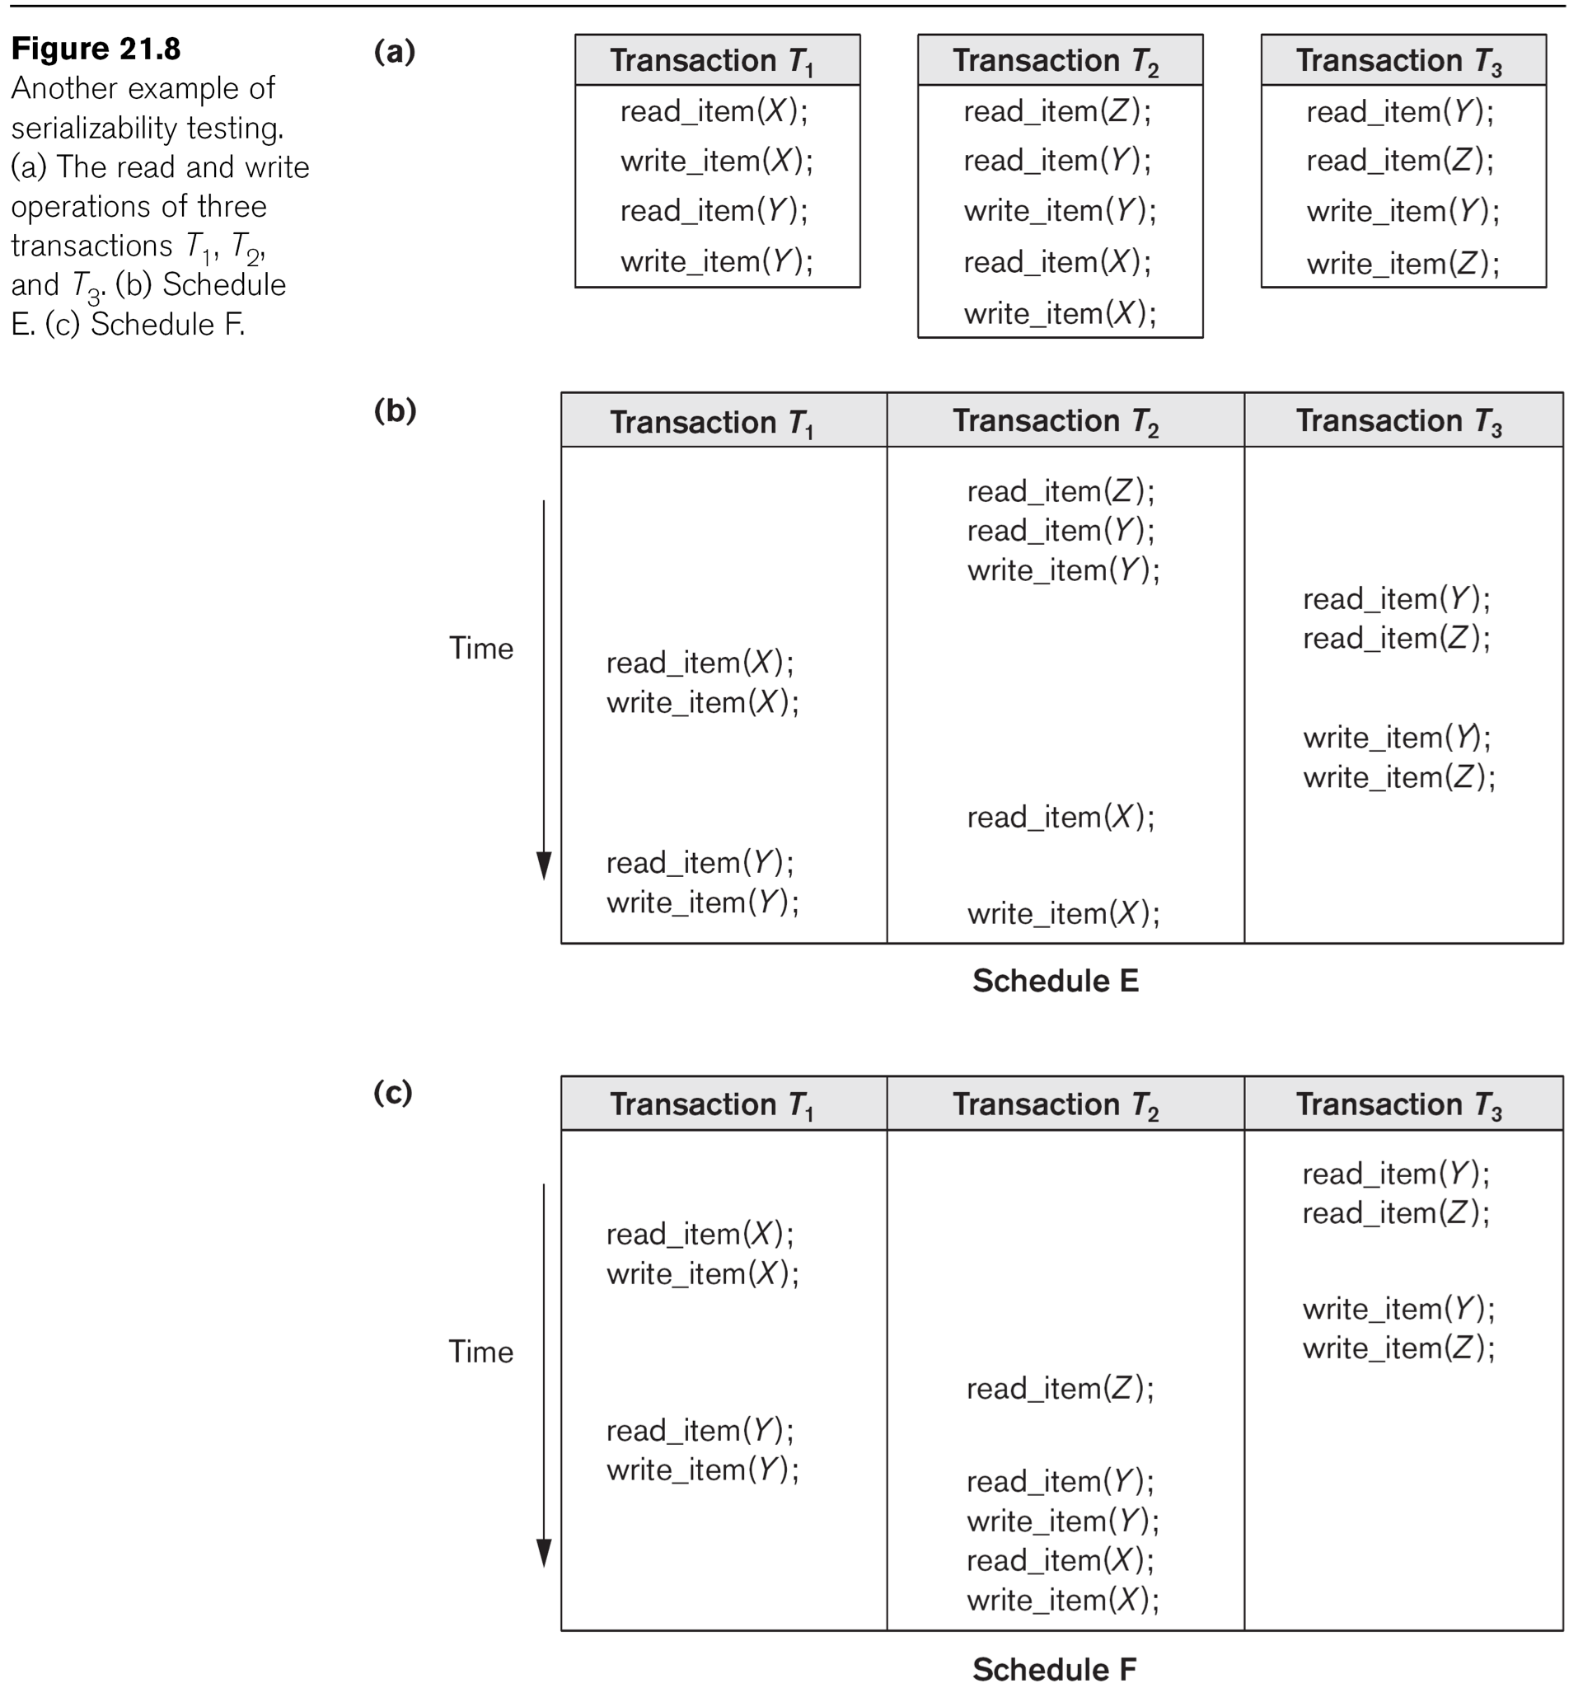

Slide 58
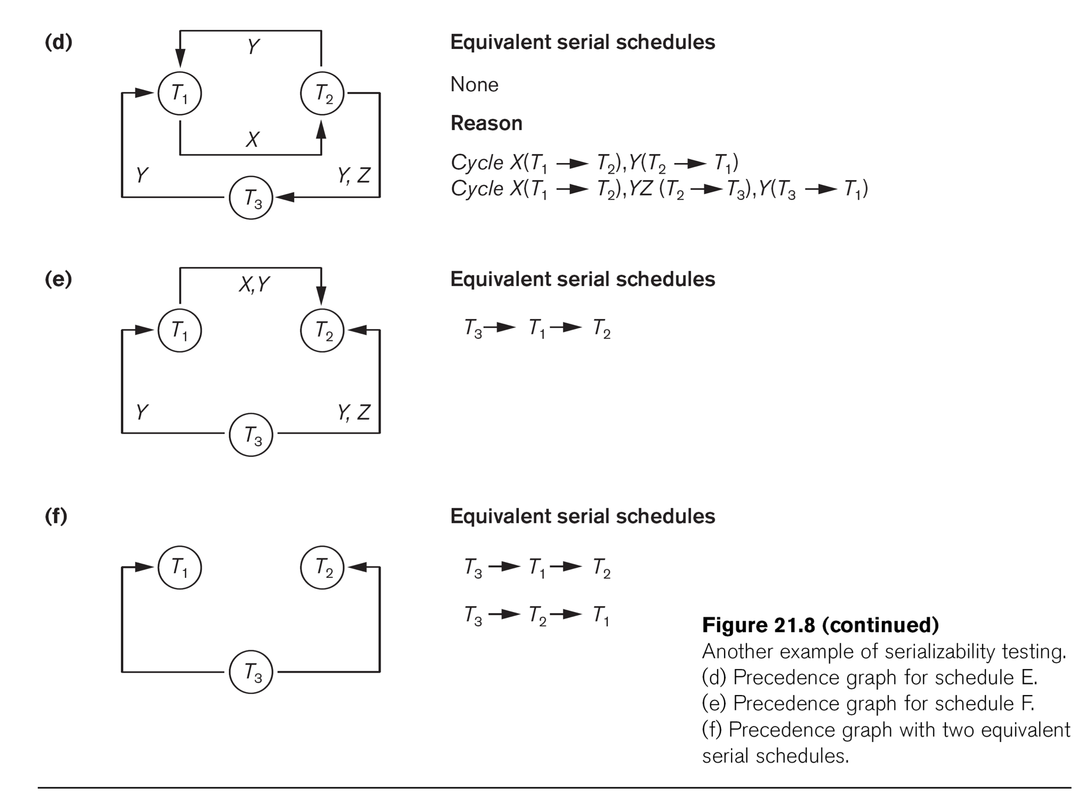

Slide 59
Characterizing Schedules based on Serializability (cont.)
View equivalence: A less restrictive definition of equivalence of schedules than conflict serializability when blind writes are allowed
View serializability: definition of serializability based on view equivalence. A schedule is view serializable if it is view equivalent to a serial schedule.

Slide 60
Characterizing Schedules based on Serializability (cont.)
Two schedules are said to be view equivalent if the following three conditions hold:
The same set of transactions participates in S and S’, and S and S’ include the same operations of those transactions.
For any operation Ri(X) of Ti in S, if the value of X read was written by an operation Wj(X) of Tj (or if it is the original value of X before the schedule started), the same condition must hold for the value of X read by operation Ri(X) of Ti in S’.
If the operation Wk(Y) of Tk is the last operation to write item Y in S, then Wk(Y) of Tk must also be the last operation to write item Y in S’.

Slide 61
Characterizing Schedules based on Serializability (cont.)
The premise behind view equivalence:
Each read operation of a transaction reads the result of the same write operation in both schedules.
“The view”: the read operations are said to see the the same view in both schedules.
The final write operation on each item is the same on both schedules resulting in the same final database state in case of blind writes

Slide 62
Characterizing Schedules based on Serializability (cont.)
Relationship between view and conflict equivalence:
The two are same under constrained write assumption (no blind writes allowed)
Conflict serializability is stricter than view serializability when blind writes occur (a schedule that is view serializable is not necessarily conflict serialiable.
Any conflict serializable schedule is also view serializable, but not vice versa.

Slide 63
Characterizing Schedules based on Serializability (cont.)
Relationship between view and conflict equivalence (cont):
Consider the following schedule of three transactions
T1: r1(X); w1(X); T2: w2(X); and T3: w3(X):
Schedule Sa: r1(X); w2(X); w1(X); w3(X); c1; c2; c3;
In Sa, the operations w2(X) and w3(X) are blind writes, since T2 and T3 do not read the value of X.
Sa is view serializable, since it is view equivalent to the serial schedule T1, T2, T3. However, Sa is not conflict serializable, since it is not conflict equivalent to any serial schedule.

